Slide 1

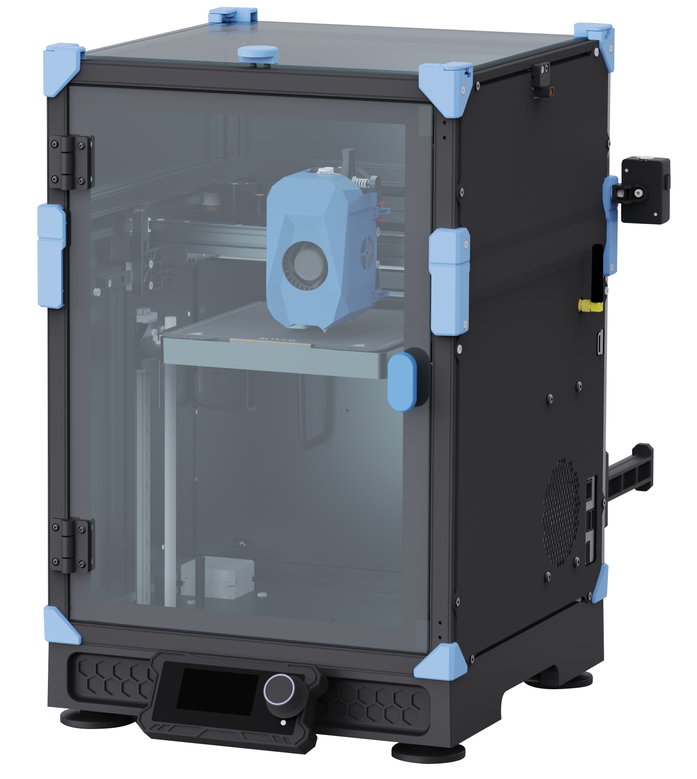
SOVOL
SOVOL ZERO
User Manual
V1.0

Slide 2

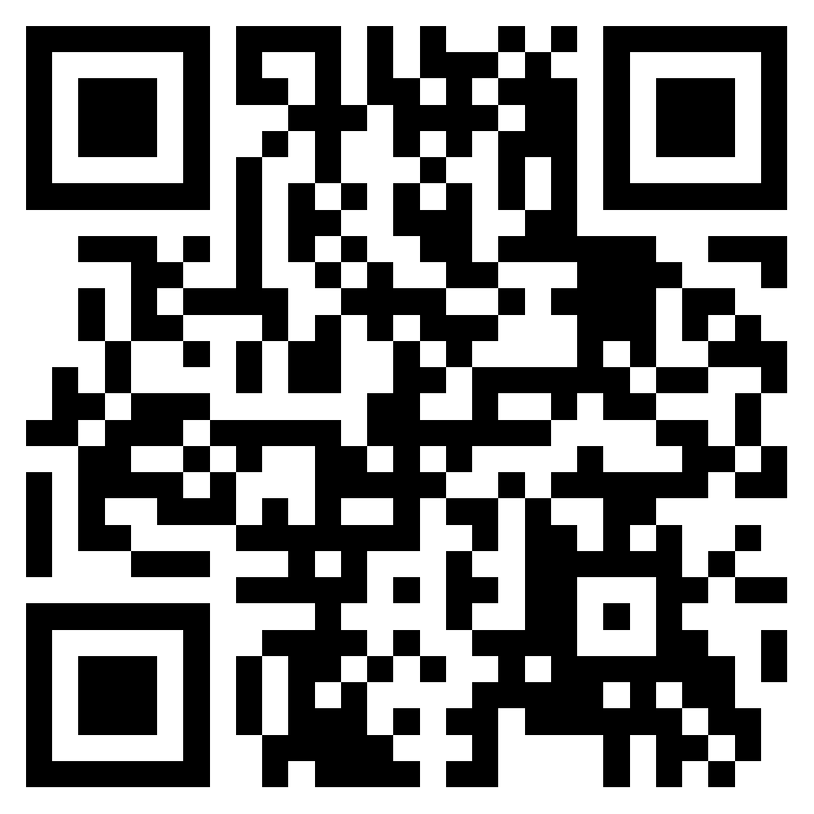
Dear customers:
Thank you for choosing Sovol printers!
Sovol is committed to providing excellent machines to 3D printing enthusiasts all over the world .This manual is designed for SOVOL ZERO owners to start their SOVOL ZERO printing journey.We still recommend all the SOVOL ZERO owners to read the manual carefully even if youare familiar with the 3D Printing technology, as there are lots of important information about the SOVOL ZERO for you to learn and help you get better printing exprience .In this manual there are some tutorials can be found on official website and group, you can scan the QR-codes.
sovol support group
sovol official website

Slide 3
Catalogue
1 Note
02
2 Equipment Parameters
03
3 Package List
04
4 Unboxing
05
Final renderings
09
5 Function List
10
6 Knob screen
11
7 Start-up
12
8 Enable camera
13
9 Fill Filament
15
10 Slicing Software
16
11 Factory Settings
17
12 Air Filter
18
13 OTA
19
14 Obico
20
15 Motherboard
23
16 Nozzle adapter
24

Slide 4
Note
Do not use the printer any way other than described here in order to avoid personal injury or property damage.
Do not place the printer in the environment with large vibration or other instability. The shaking of the machine will affect the printing quality of the printer.
Please do not place the machine in inflammable and explosive materials or near high
heat source.
Please place the machine in a ventilated, cool and dust free environment.
It is recommended to use the material recommended by the manufacturer to avoid
machine damage.
Do not use any other power cable except the one supplied. Always use a grounded
three-prong power outlet.
Please do not open the plastic cover during usage, otherwise the printing will be
interrupted.
Do not wear cotton gloves when operating the printer. Such cloths may become tangled in the printers moving parts leading to burns, possible bodily injury, or printer damage.
Please wait a moment to remove the print after the print is finished.
It’s not recommended to use the third party firmware or mainboard etc, or the
warranty will be void.
Clean the printer frequently. Always turn the power off when cleaning, and wipe with a dry cloth to remove dust, adhered printing plastics or any other material off the frame, guide rails, or wheels. Use glass cleaner or isopropyl alcohol to clean the print surface.
Children under 10 years should not use the printer without supervision.
This machine is equipped with a security protection mechanism.Do not manually
move the nozzle and printing platform mechanism manually while booting up,ot
herwise the device will automatically power off for safety.
Users should comply with the laws and regulations of the corresponding countries and regions where the equipment is located (used), abide by professional ethics, pay
attention to safety obligations, and strictly prohibit the use of our products or
equipment for any illegal purposes. Sovol will not be responsible for any violators'
legal liability under any circustance.
Regularly clean the rails and leadscrews, and apply grease for maintenance.

Slide 5
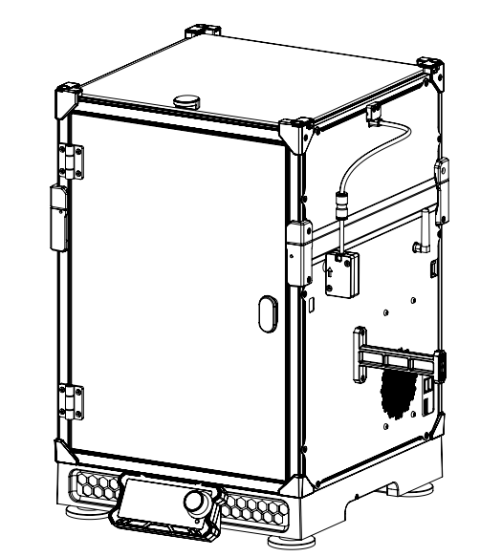
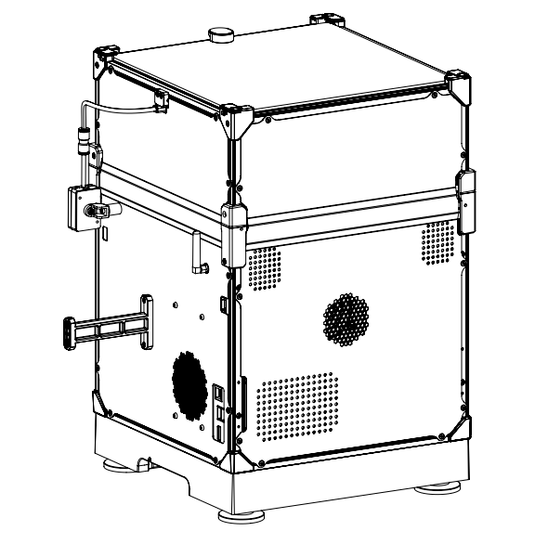
Equipment
Parameters
Model | SOVOL ZERO
Software language | English
Print method | Network interface USB cord and WIFI
Type | FDM
Number of nozzles | 1
Print size | 152.4*152.4*152.4mm
Recommend Printing speed | ≤500mm/s
Printing accuracy | ±0.1mm
Nozzle diameter | 0.4mm (Replaceable)
Nozzle temperature | ≤350℃
Hot bed temperature | ≤120℃
Applicable filament | PLA/ABS/PETG/TPU
Diameter of filament | 1.75mm
File format supported | G-code
Voltage | AC 100~120V / 200~240V, 50/60Hz,
Operation system | Windows,Mac
Power supply | 150W/24V

Slide 6
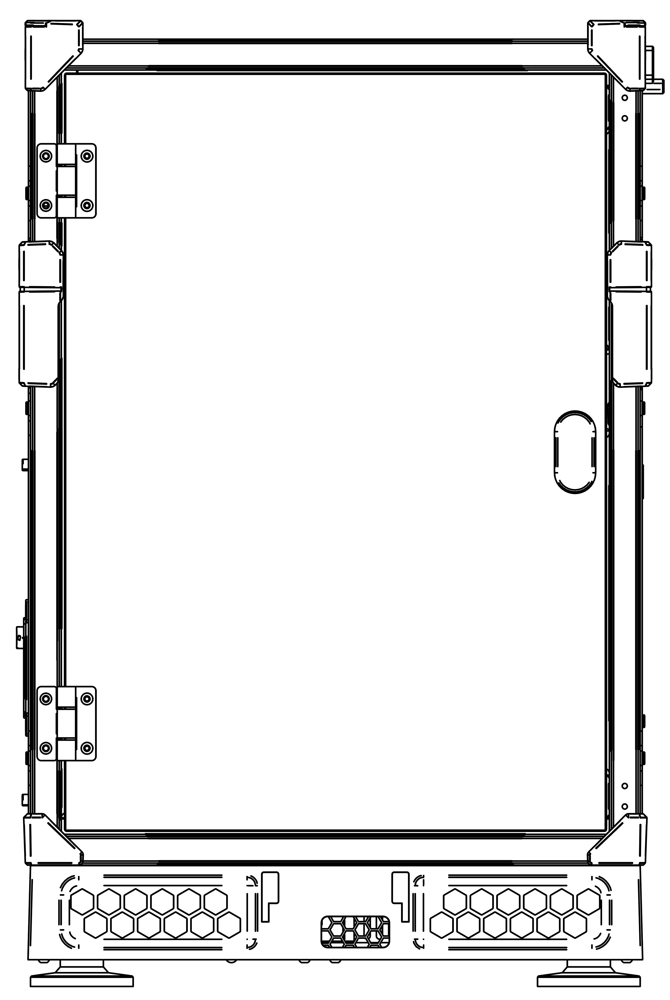

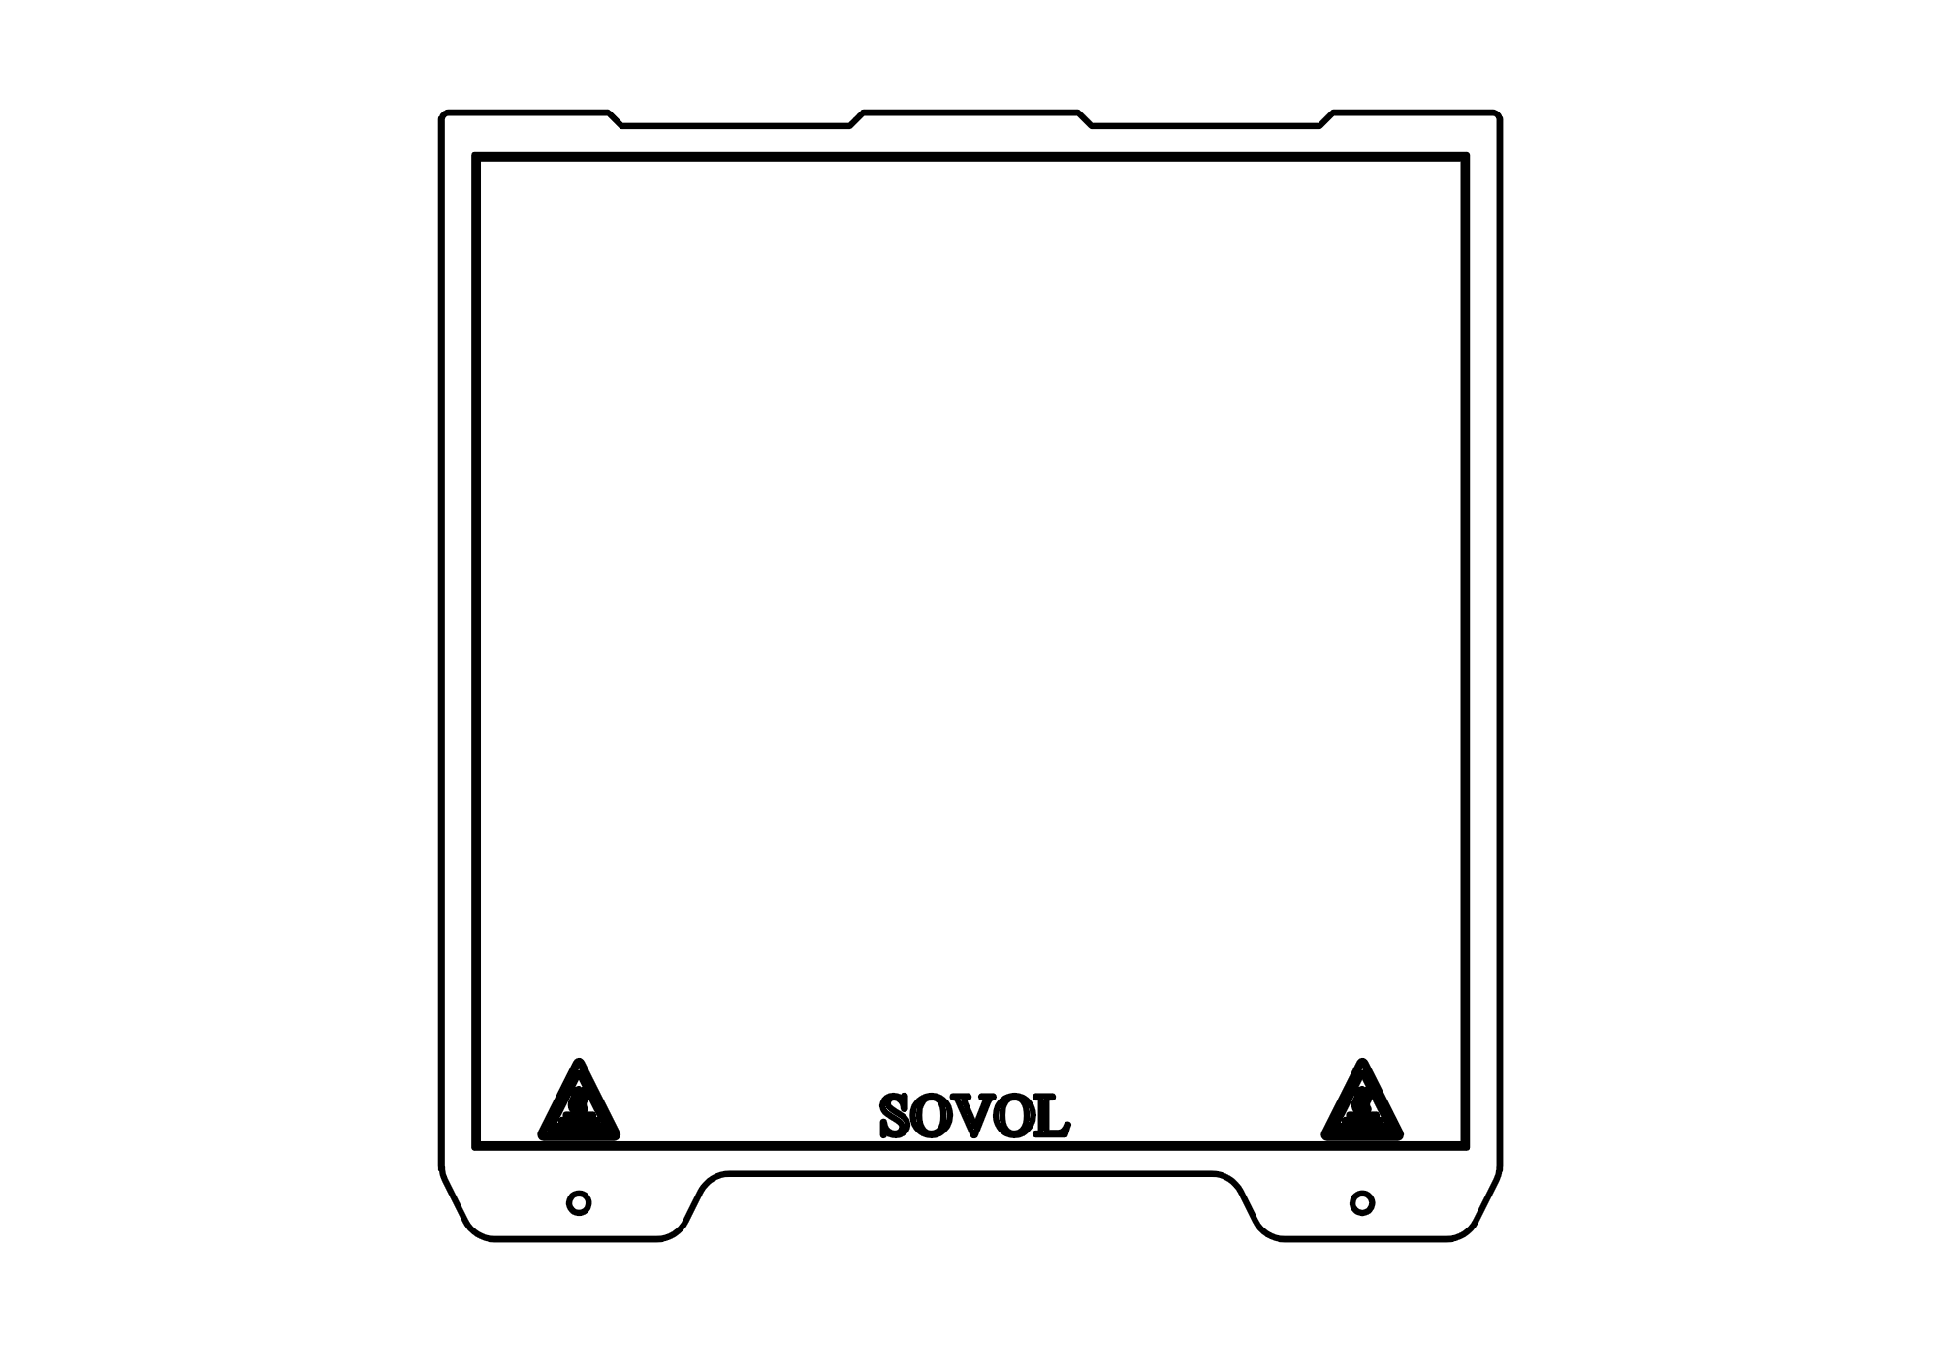
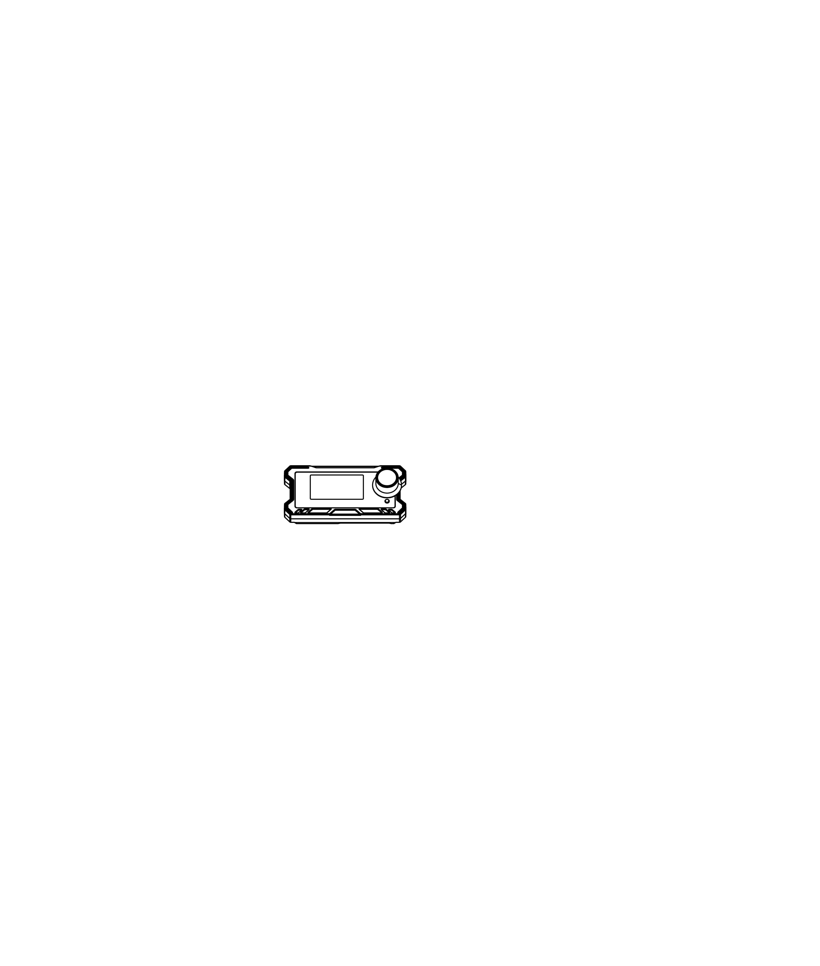
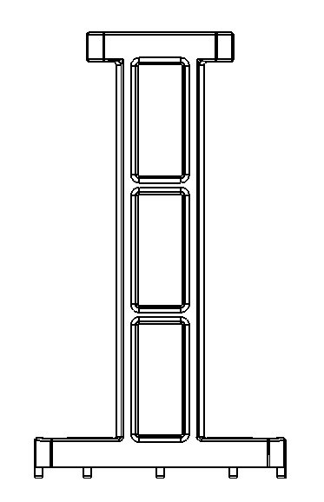
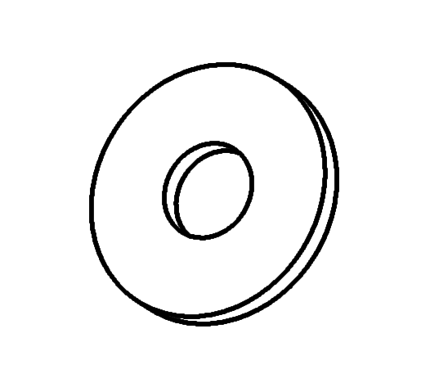
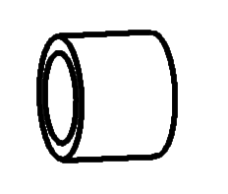
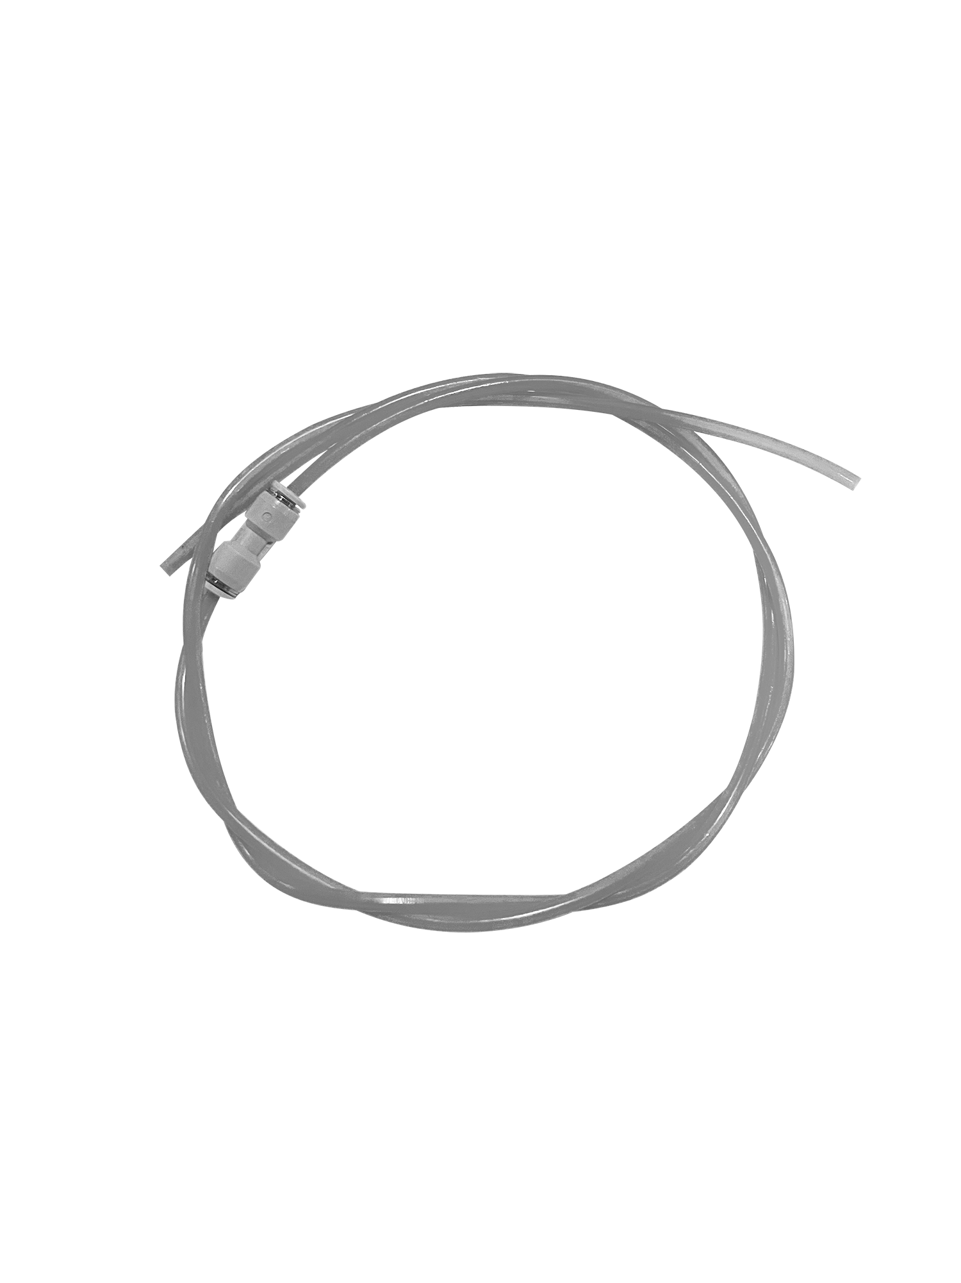
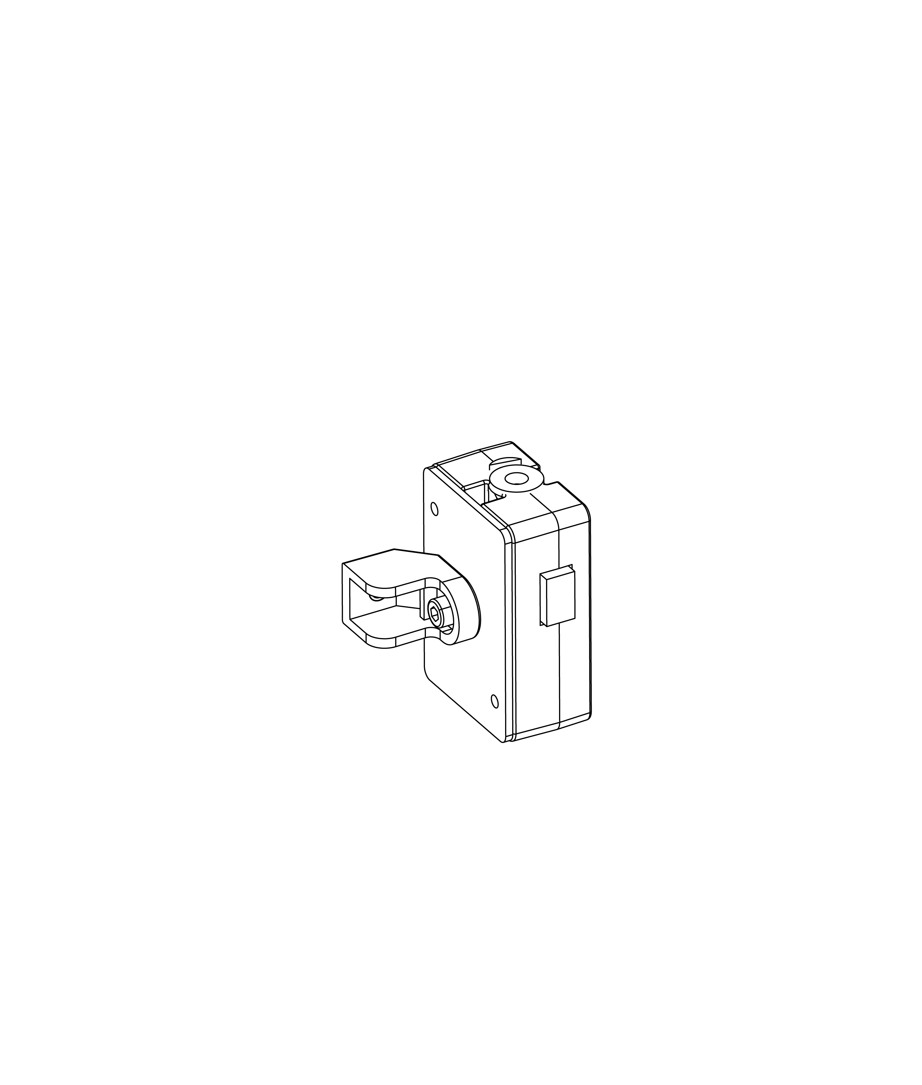

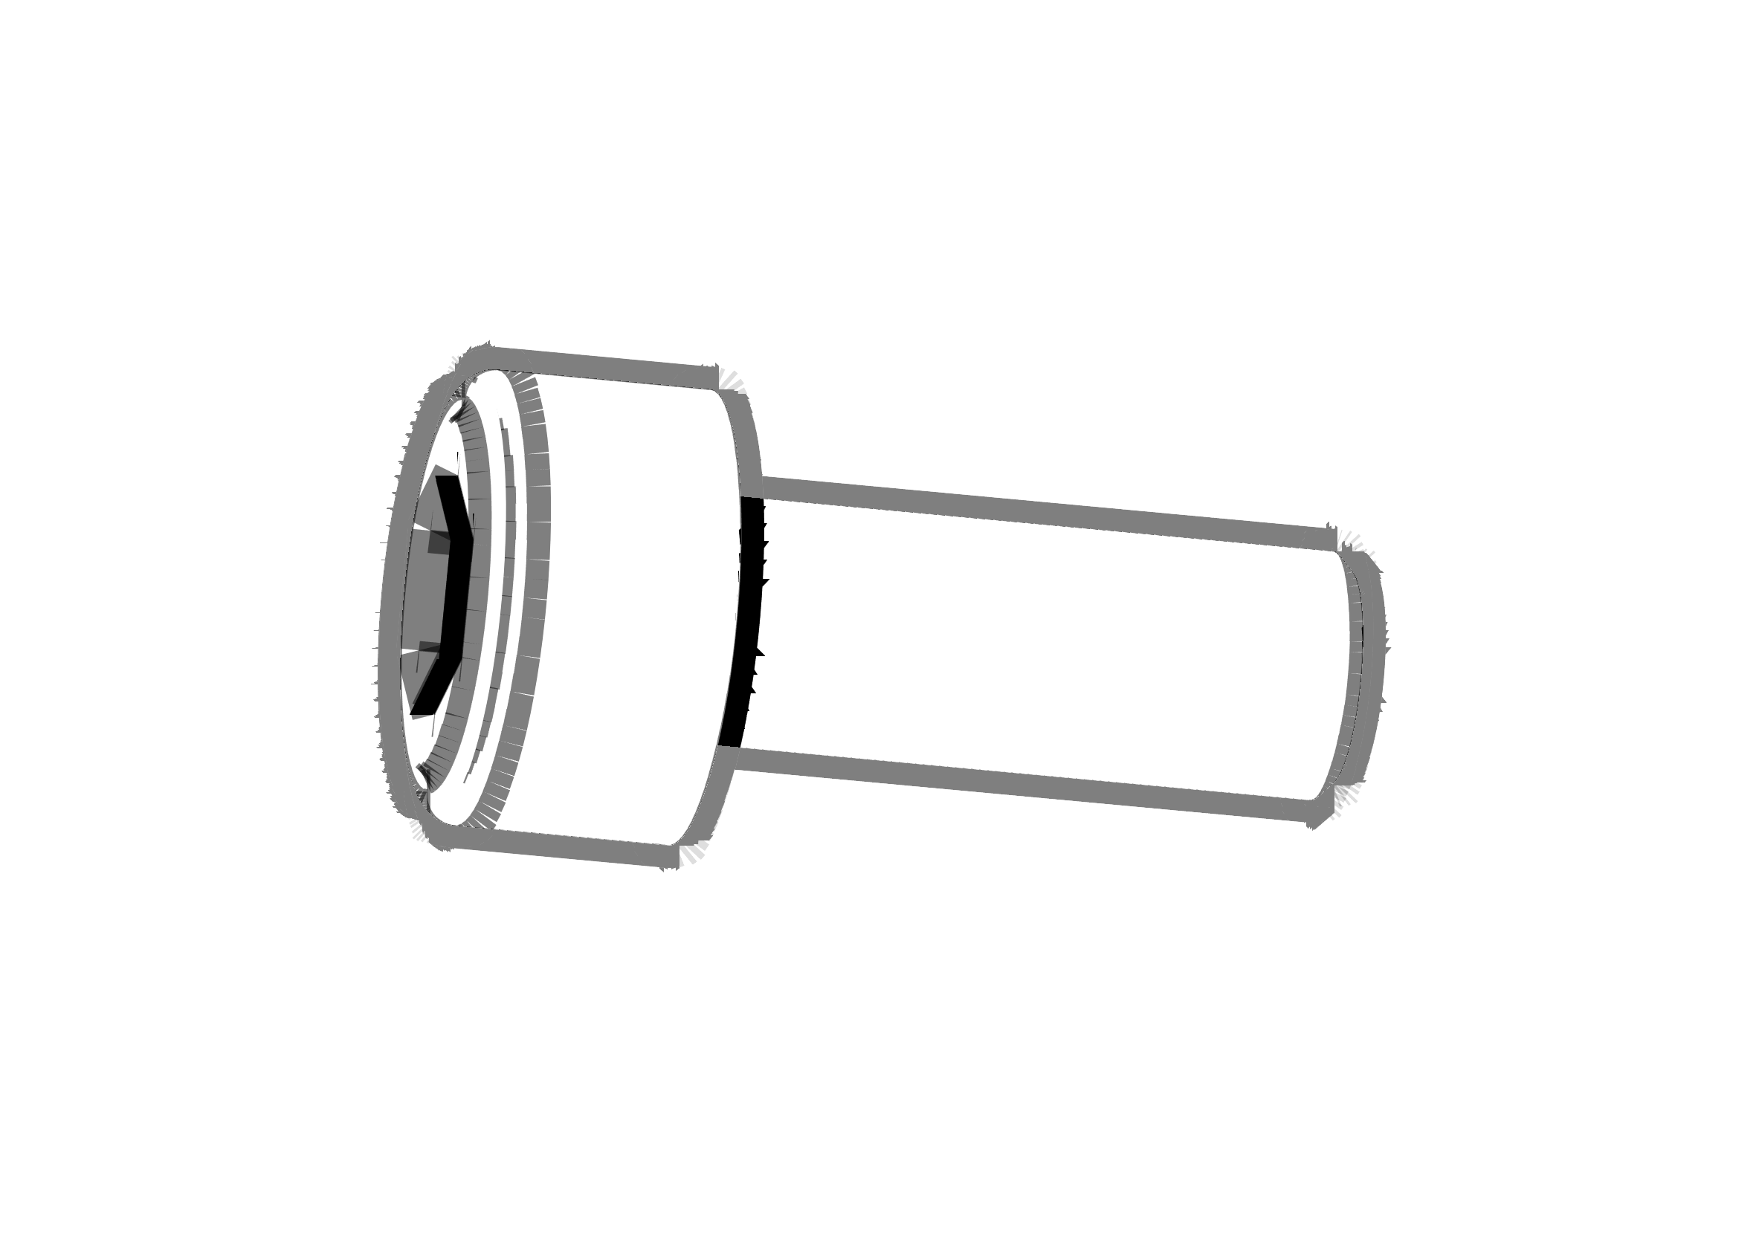
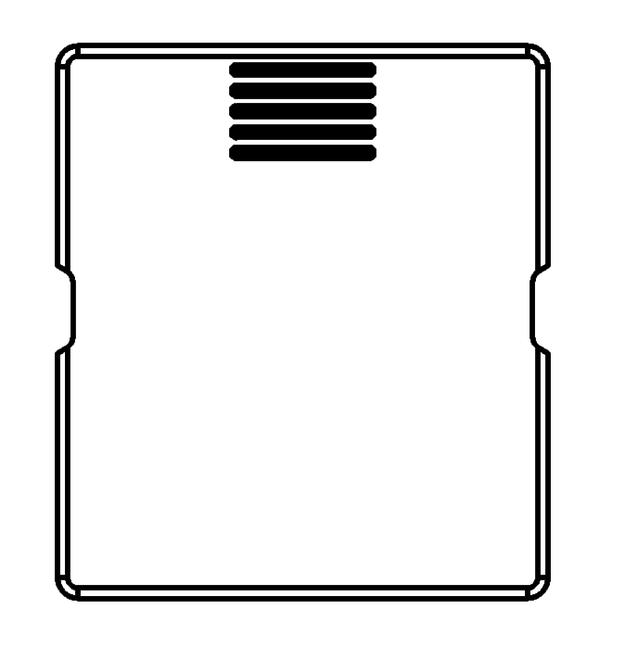
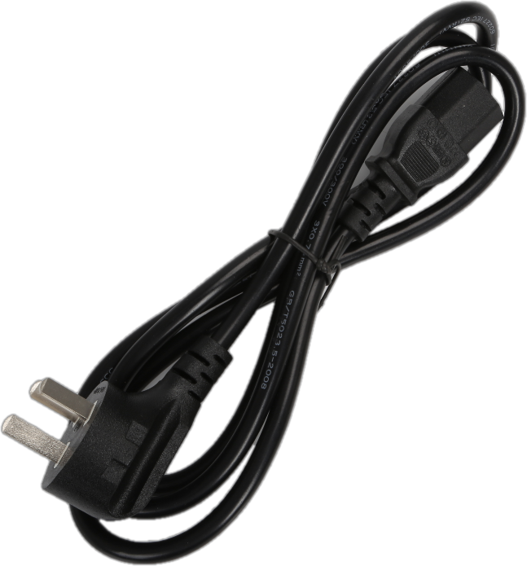
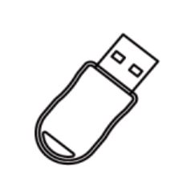
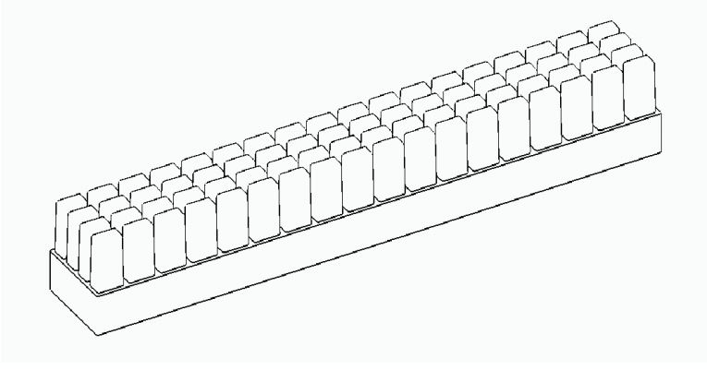
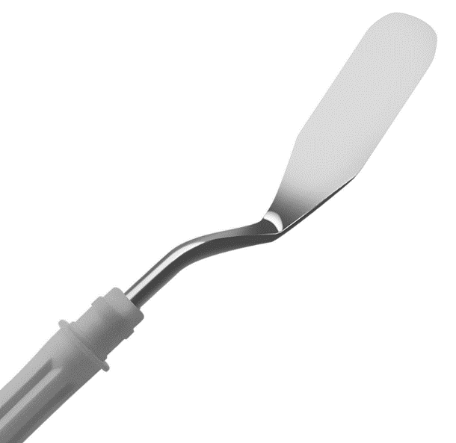
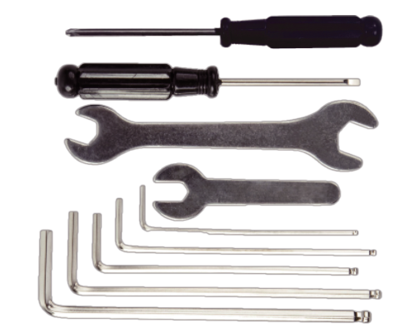
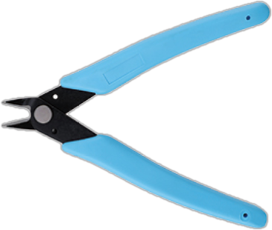
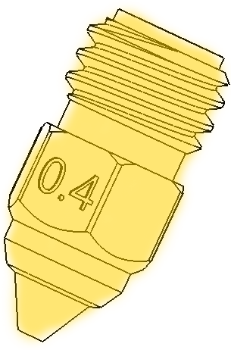
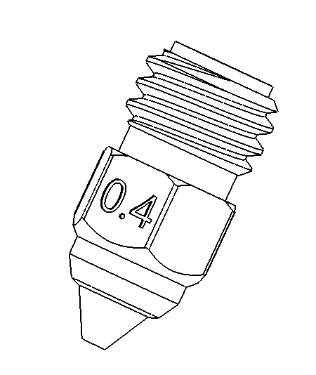
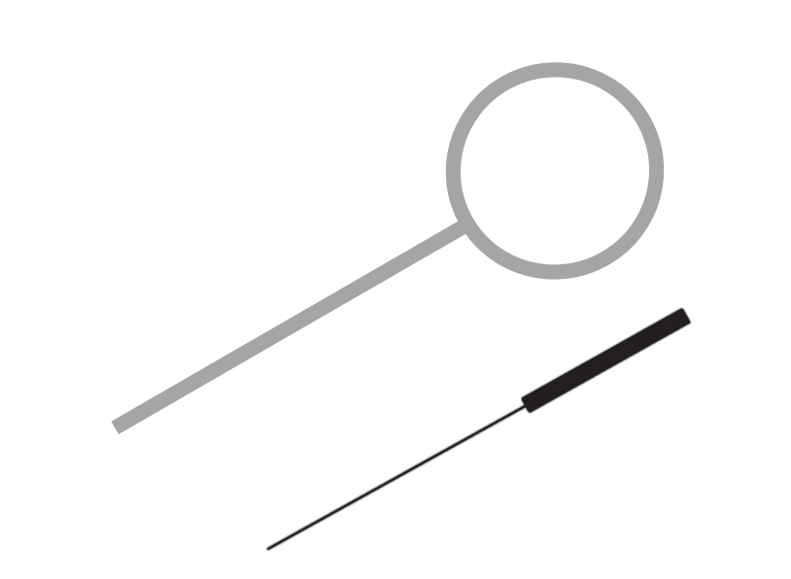
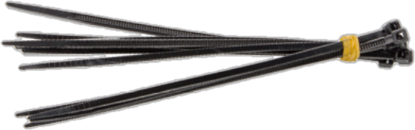
Package List
Top Glass Cover
PEI Plate
Knob Screen
Printer
Tool Box
Gasket
Isolation column
PTFE Tubing
Spool Holder
M3X16*3
Filament Detector
Filter protection cover
WiFi Antenna
Power cord
USB Flash Disk
Silicone brush
Scraper knife
Toolkit
Diagonal pliers
Brass and Hardened Steel Nozzle
Nozzle Cleaner
and Zip Tie

Slide 7
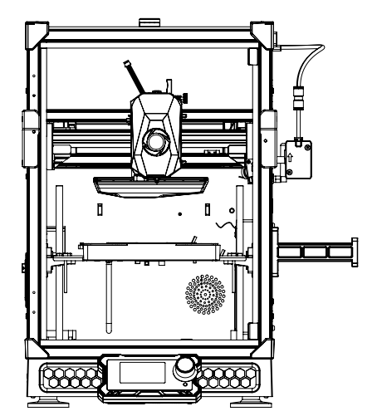
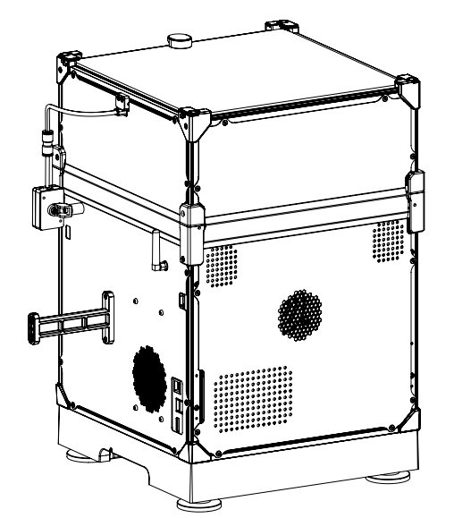
Unboxing
Mian frame installation
Filament Detector
Extruder Nozzle
Auxiliary Cooling
Fan(Rear)
Camera
Cavity heat dissipation
and Air Filter
Hot Bed
Knob Screen
Cable Ties
WiFi Antenna
Spool Holder
Power Supply Switch
(Left Side)
RJ45 Network Port
USB Port
HDMI Port

Slide 8

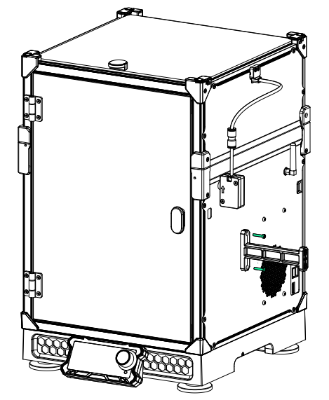
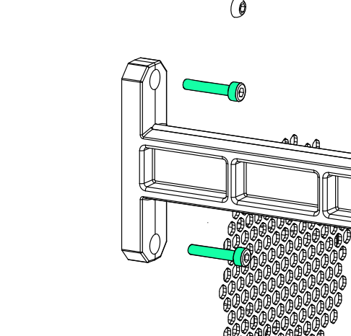

Unboxing
Unpack the outer package, take the printer out of the box, and place it on the desk. After removing all the foam, put the other accessories aside, and follow the steps below for installation.
Screen Installation:
There are two screen cables directly below the machine. Insert each cable into its corresponding hole in sequence, then snap the screen into the designated slots at the bottom.
M3X16
Installation of the rack:
First, insert two M3X16 screws into the corresponding holes at the lower left corner and tighten them.

Slide 9
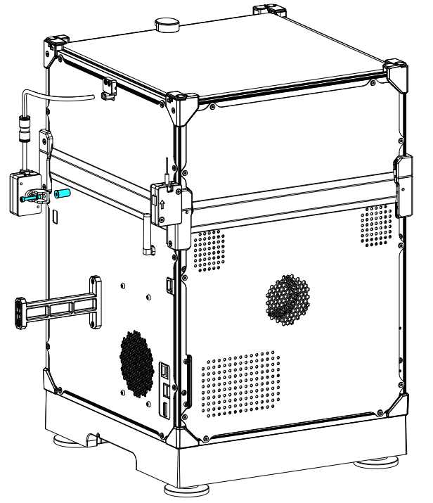


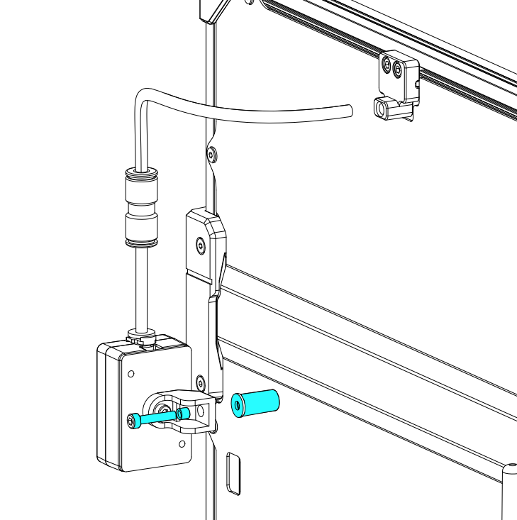
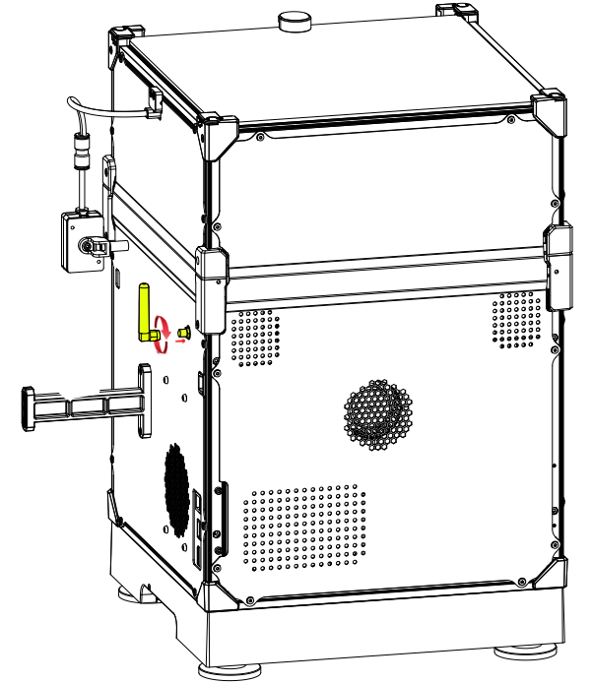

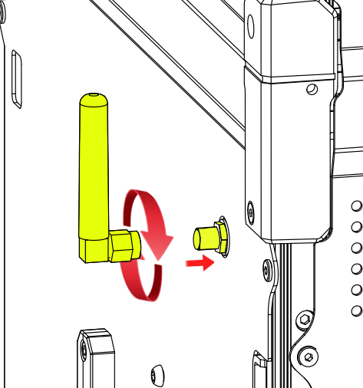
Unboxing
material breakage detection：First, the PTFE tube on the extrusion nozzle should be threaded out of the fixed bracket (as shown), inserted into the material breaking detection, and then the M3x16 screw in the kit should be put into the pre-lock hole and locked.
Isolation column
M3*16
Isolation column
Gasket
Installation of WiFi antennas ：Take out the upper half of
the WiFi antenna, insert
the corresponding hole
and tighten it in a clock
-wise direction.

Slide 10

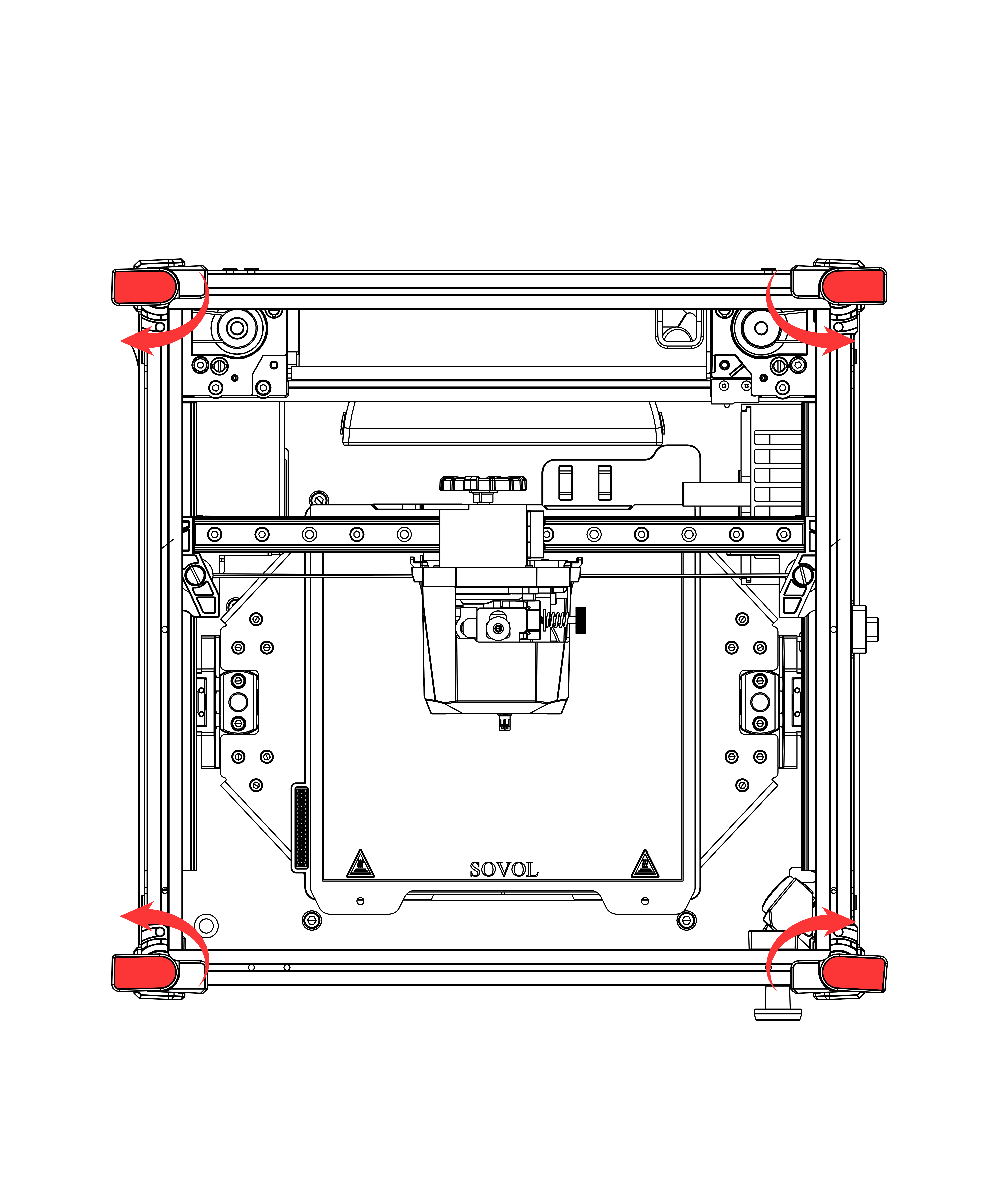
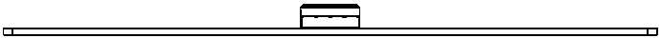
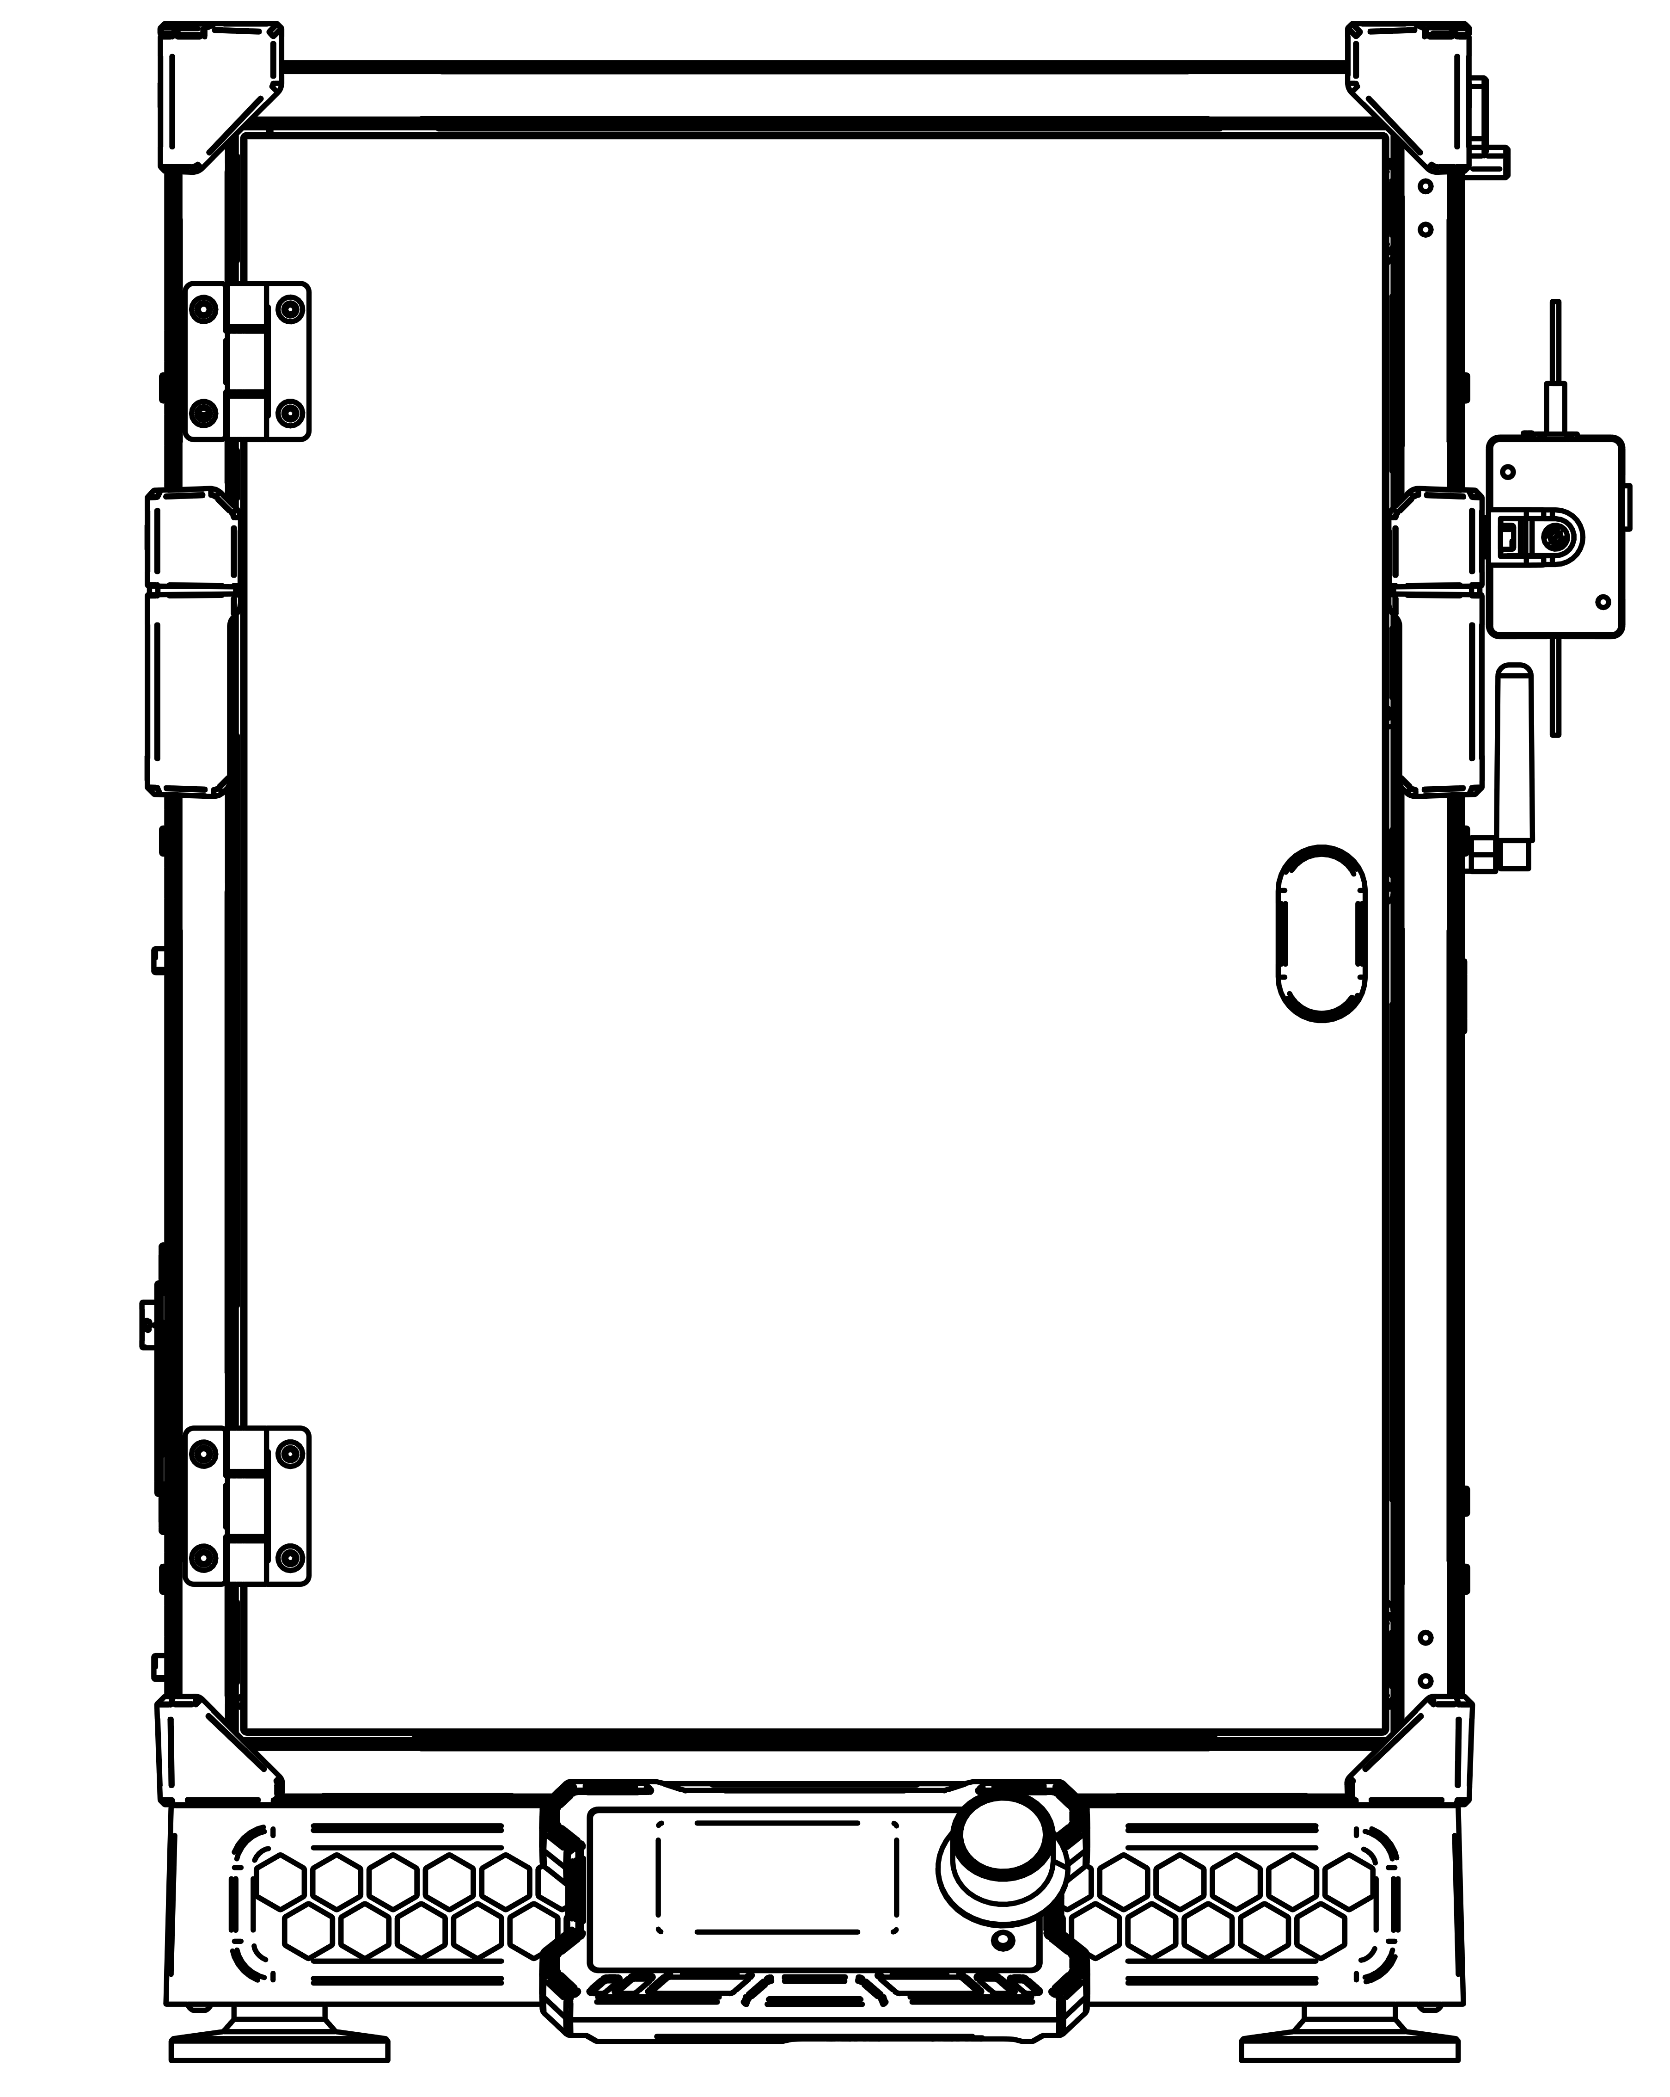

Unboxing
Installation of glass cover：
We turn the top corner of the machine, turn it outward (as shown), cover the glass cover and turn it back to complete the installation.
Finally, The PEI plate needs to be placed on the hot bed first.
PEI plates need to be cleaned regularly to ensure that the surface is grease-free.

Slide 11
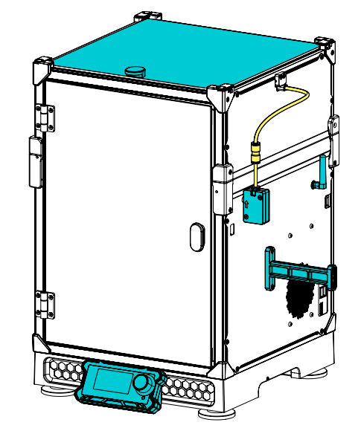
Unboxing
Final renderings

Slide 12
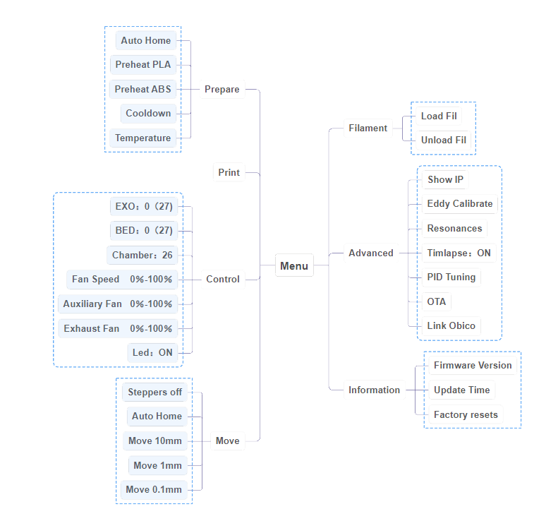
Function List
Updates may differ, please refer to the latest firmware version. If you have any questions during use, please contact us, and we will respond as soon as possible.

Slide 13
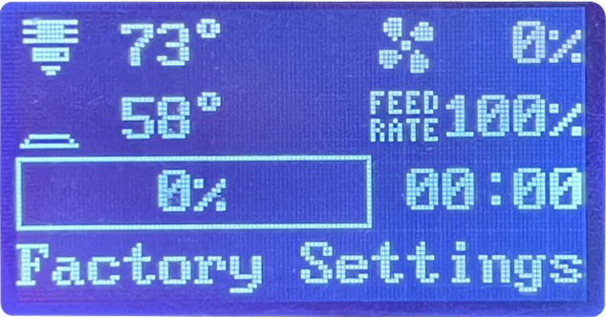
Knob Screen
Mian
1. Nozzletemperature
5. Fan rotation
speed percentage
2. Heating bed
temperature
6. Printing speed
3. Printing
progress bar
7. Printing progress time
4. Printer status
Note: The current interface is for reference only, due to the continuous upgrading of functions, the actual latest software/firmware UI on the official website shall prevail.
1. Nozzle temperature: Displays the current temperature/preset
value temperature of the nozzle
2. Heating bed temperature: Displays the current temperature/
preset value temperature of the heating bed
3. Printing progress bar: displays the printing progress percentage,
starting printing 0% - printing completed 100%
4. Printer status:There will be four states appearing at this time.
5. Fan rotation speed percentage: displays the cooling fan rotation
speed percentage, 0%-100%
6.Printing speed:displays the current printing speed.Printing speed
can be adjusted with the knob.
7. Print progress time: Shows how long the print model has been completed.
1
Ready : The machine is ready
Power Recovery : Power-resume print function
Factory Settings : Factory reset
TiP code : Knob screen code
2
3
4

Slide 14
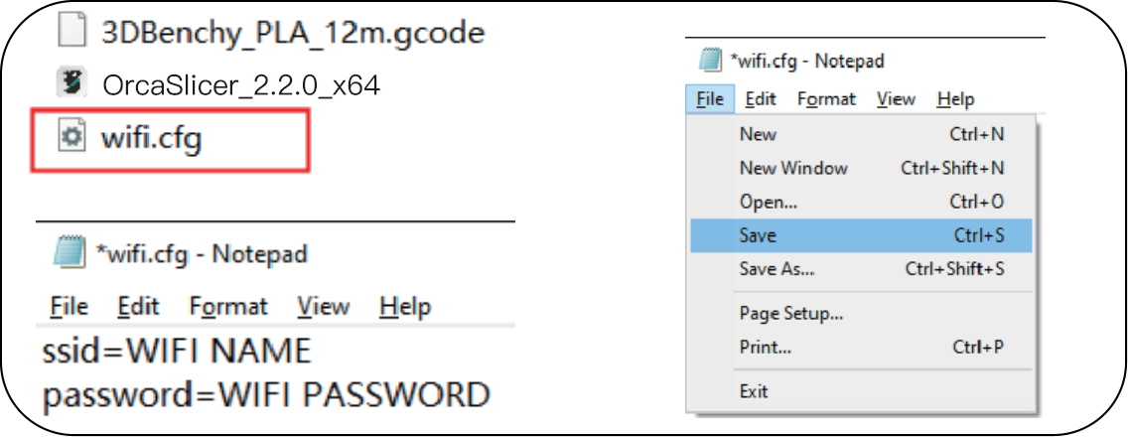
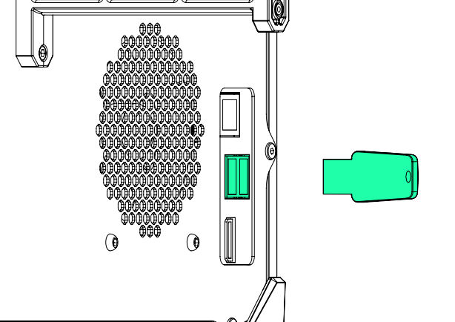
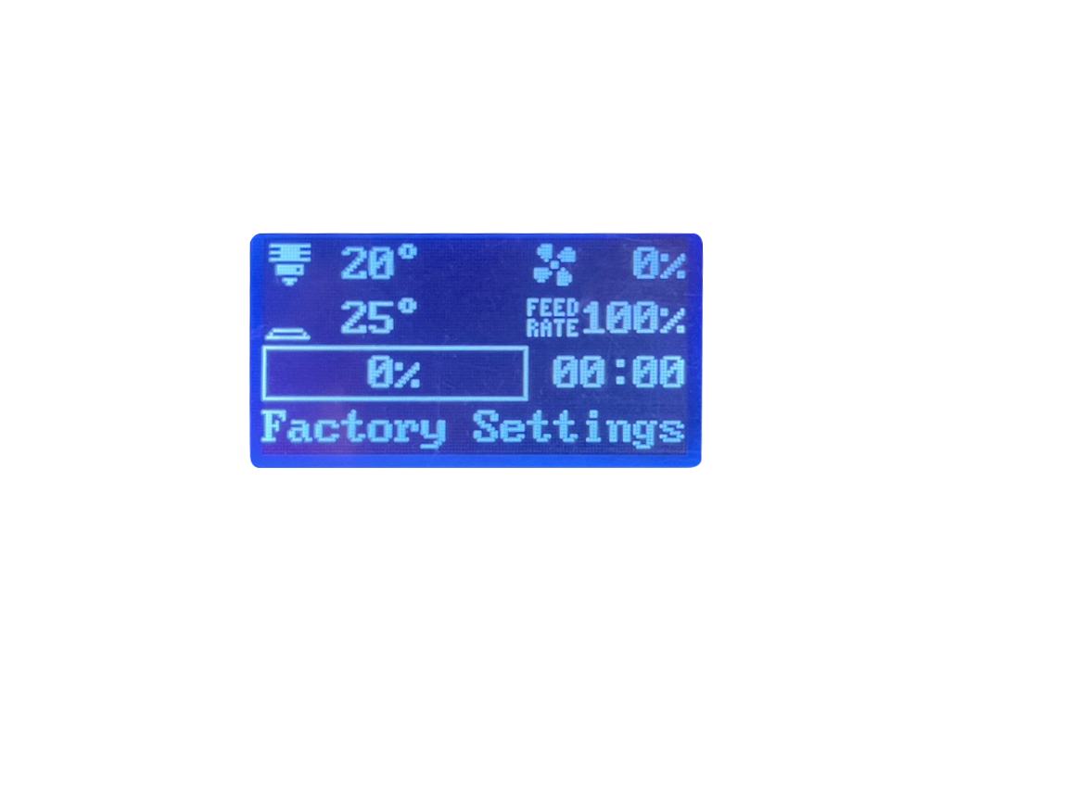
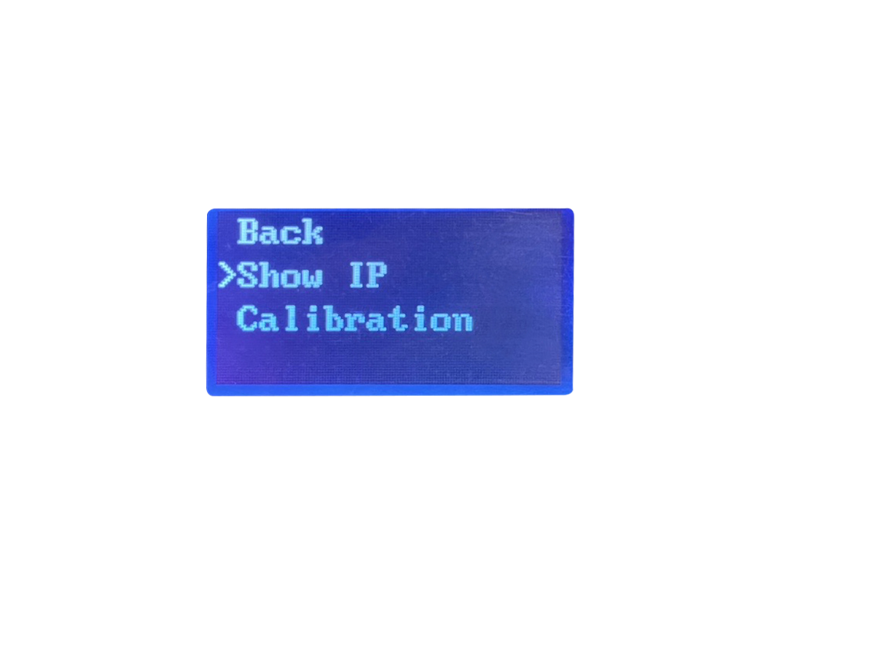
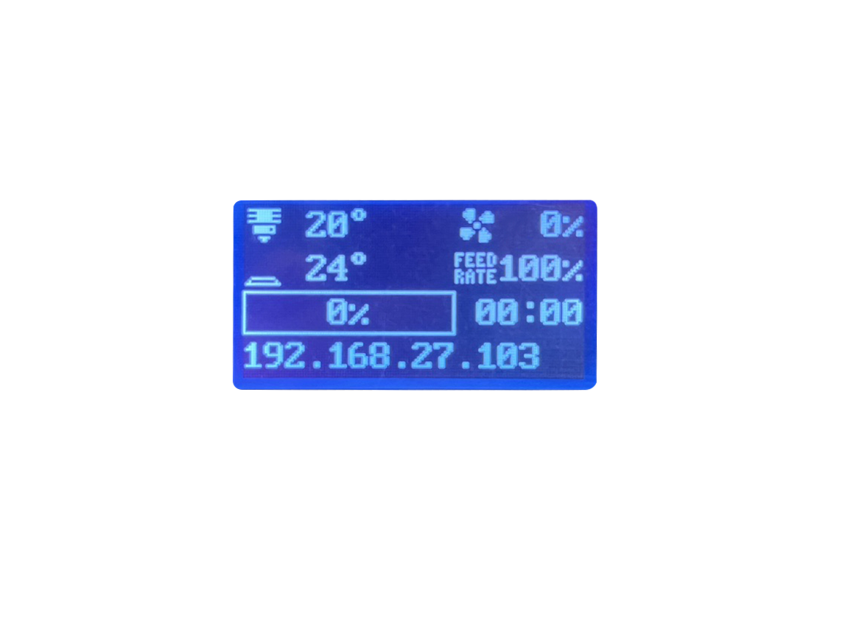
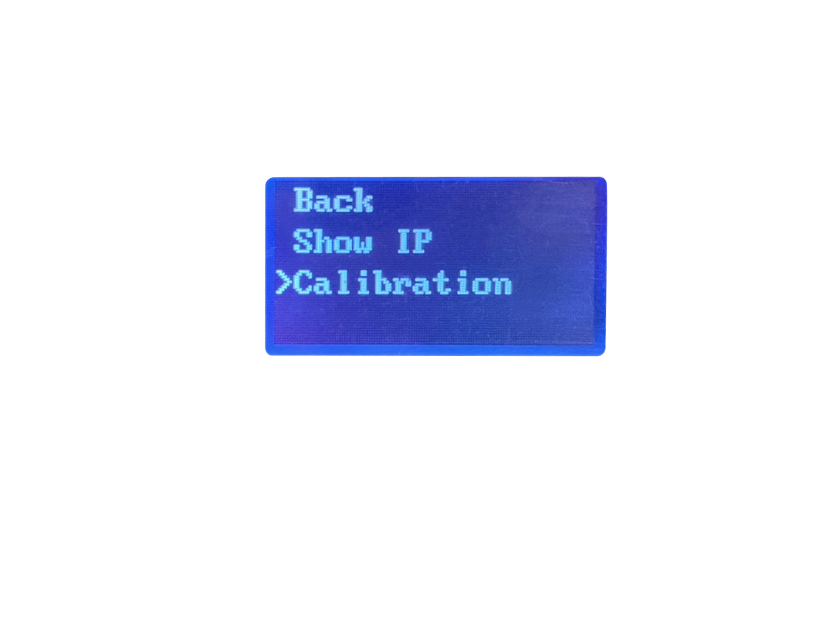
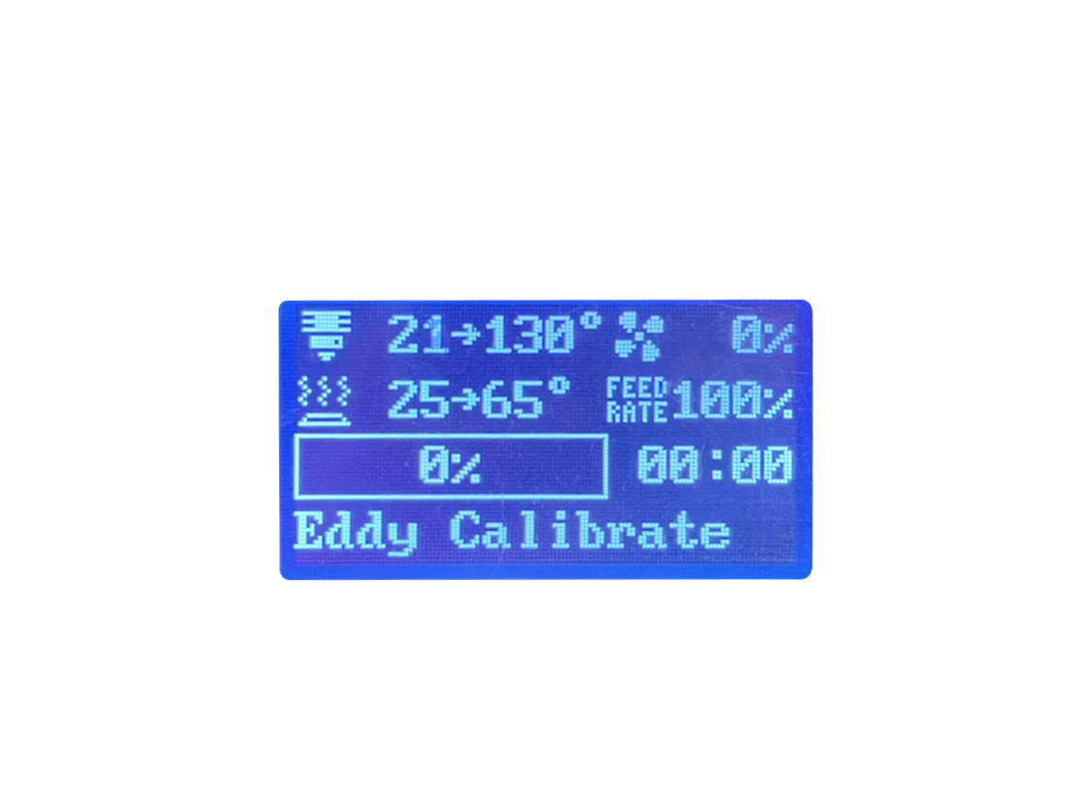
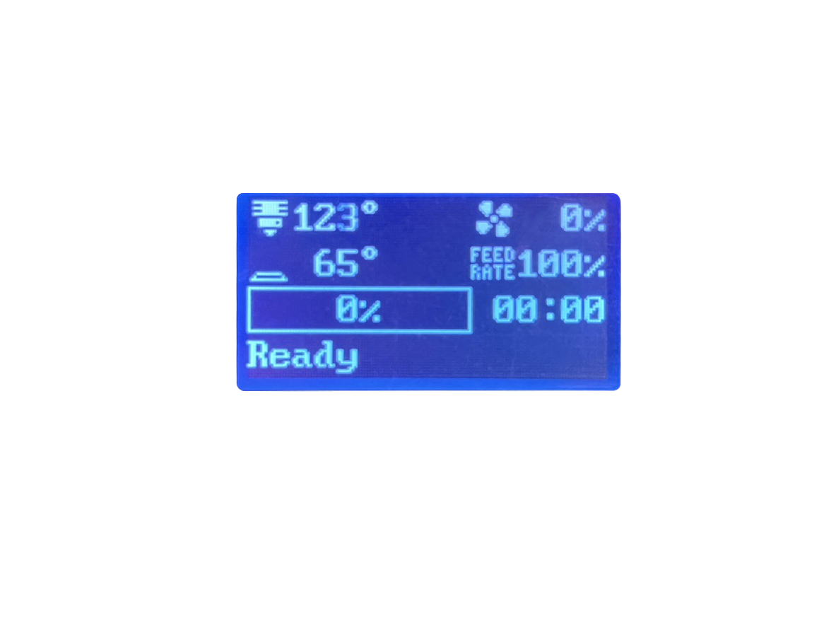
Start-up
1.Use the USB flash drive included in the machine's accessory package and insert it into your .
computer to access its contents. Search for the file named “wifi.cfg" within the drive.
2.Open the “wifi.cfg" file using Notepad;
this action resembles the example displayed
on the right. Enter your WiFI network name
(SSID) and password in the following format:
- ssid=your_WiFi_network_name
- password=your_WiFi_password
Example:
- ssid= WiFi NAME
- password= WiFi Password
3.After entering your WiFi info, save the “wifi.cfg" file, ensuring it remains in the USB's root directory.
*Please make sure you type in the correct WiFi info.
4.Power on the machine, enter the system and then plug
the USB port into one of the two USB ports on the right
side of the machine.Once inserted, pause for 15-20 seconds
before continuing.
5.Press the knob to select ‘Show IP" and wait for 5-10s. The IP adress of your home network will appear.If 127.0.0.1 appears, we need to check if the Wi-Fi account and password in the USB drive's files are correct, or if the USB drive is properly inserted, and then restart the machine to perform the above actions again.
6.After the machine is connected to Wi-Fi, press the knob again to select the auto-calibration function, the machine will automatically calibrate and then restart.

Slide 15
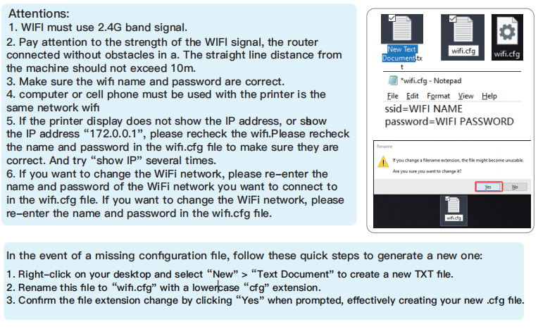
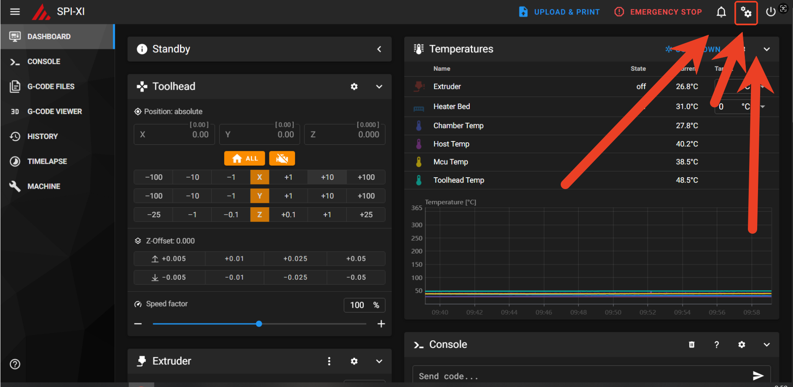
Enable
camera
Enable camera
After the machine successfully connects to the network, operate "Show ip" on the screen to obtain the machine's network IP. We need to enter the IP address in the web interface within the same LAN to log in to mainsail (accessible from both mobile devices and computers). Please follow the steps below to enable the camera.

Slide 16
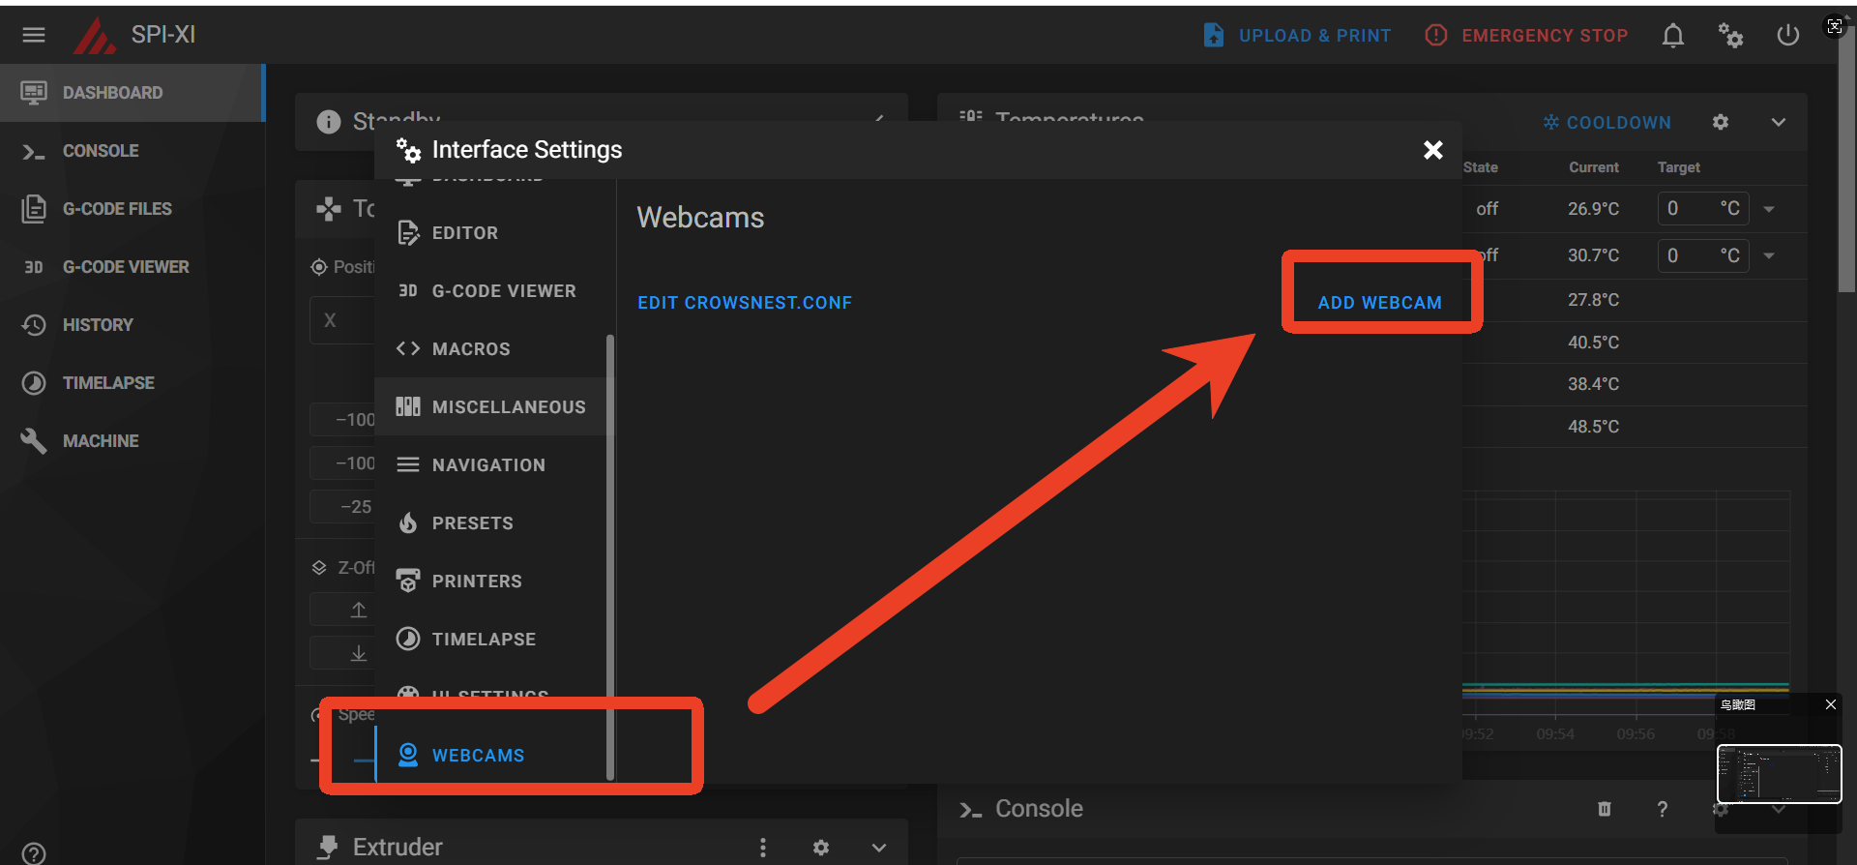
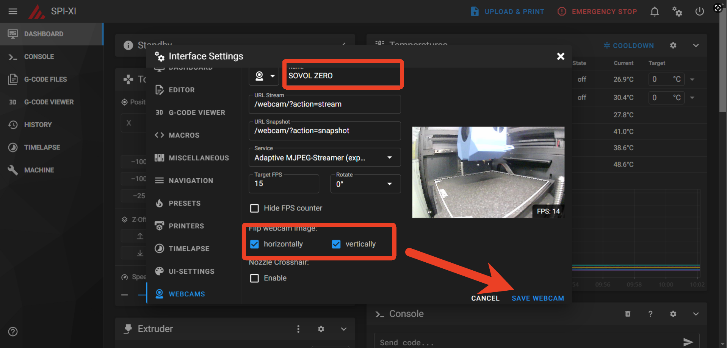

Enable
camera

Slide 17








Fill Filament
Use the scissors in the accessory kit to cut off the
end of the filament at a 45° angle.
Steps to insert filament: Insert the filament into the hole of the filament runout sensor until it reaches the end. When the consumables cannot be inserted any further, complete the stepof inserting filament.
Make sure the filament are loaded correctly & are engaged with the extruder gears.
Select the "Load Fil" function, the heating block will heat
up,reach the specified temperature value, the E-axis extrusion motor starts to rotate, the E-axis motor rota
-tion process can check whether the consumables have
been loaded, confirm the extrusion normal, the loading
of consumables step is completed.
After completing the consumables procedure, if no consumables appear in the nozzle, repeat the preceding operations.
After the nozzle is loaded with the required filament, it is essential to check if there is any leftover filament on the nozzle. If there is leftover filament on the nozzle, the return to zero reset will be inaccurate, and the nozzle will scratch the PEI plate, which damages both the nozzle and the PEI plate, significantly reducing print quality and performence.
Please keep it clean

Slide 18





Slicing
Software
The latest version in official website shall prevail
OrcaSlicer_2.2.0_x64
Files installed in the USB “OrcaSlicer”.
Select add “SOVOL ZERO”
Select and add the model you want to print.
You can view the Show
Ip during printing

Slide 19






Factory
Settings
1
During the 3D printing process, if the filament runs out, the machine will trigger the material break detection warning, and we need to unload the residual filament.
When loading new filaments, you need to feed the filaments through the material breaking detection to the extrusion wheel of the nozzle, then select to load the filament. Once filament is extruded from the nozzle, select to continue printing; if the filament fails to extrude, release the extruder handle, remove the filament, and repeat the above steps.
2
3
During the unloading process, the air tube connector on the front end needs to be removed, and the remaining filaments should be taken out.

Slide 20


Air Filter
Air filtration system installation
When you need to print high-temperature filaments such as ABS, PC, CF,nylon,etc., you need to take out the filter protection cover in the accessery pack, align the hole on the air filter and install it【As shown in the following picture】to start printing.
Filter protection cover

Slide 21








OTA
OTA upgrade：
When our firmware version is at a lower version, please update the firmware version in a timely manner. This update can be completed by operating on the device itself.
①.Click on ‘Advanced’
②.Click on ‘OTA’
③.Click
The system will check for updates, wait for the updates to complete, and the machine will automatically restart.After the update, please power off and restart.
During system checks, if it is already the latest version, "latest version" will be displayed.

Slide 22




Obico
Obico Download
a. For Android users: visit the Google Play store,search
for“Obico” and select install app.
b. For iOS users: Visit the Apple APP Store, search for
“Obico”, and then select Install APP.
c. Via Web interface: If you want to access via Web interface
https://obico.io
1. Start the Obico operating interface of the printer
and follow the steps below.
2. Connect the Obico software on your phone.
Open Obico downloaded from the above website
①.Click on ‘SKIP’
②.Click on ‘Sign Up/Sign in’
③.Register an account, enter
the information, and click
on ‘SIGN UP’
④.Enter the account information
and click on ‘SIGN IN’

Slide 23






Obico
⑤.Click on the menu page
⑥.Link New Printer
⑦.Click
⑧.Click
⑨.Click
⑩.Click

Slide 24



Obico
Select the obico function on the machine and a 5-digit verification code will appear.
⑪ Printer connected successfully
Updates may differ, please refer to the latest firmware version. If you have any questions during use, please contact us, and we will respond as soon as possible.

Slide 25

Motherboard

Slide 26

Nozzle
adapter

Slide 28

sovol support group
sovol official website
SHENZHEN Liandianchuang Technology CO., LTD.
Official Website: sovol3d.com
E-mail: info@sovol3d.com

